Slide 1

CRM Product
Overview

Slide 2
Contents
1
BOSS System Architecture
2
CRM Product Overview
3
Billing Product Overview

Slide 3
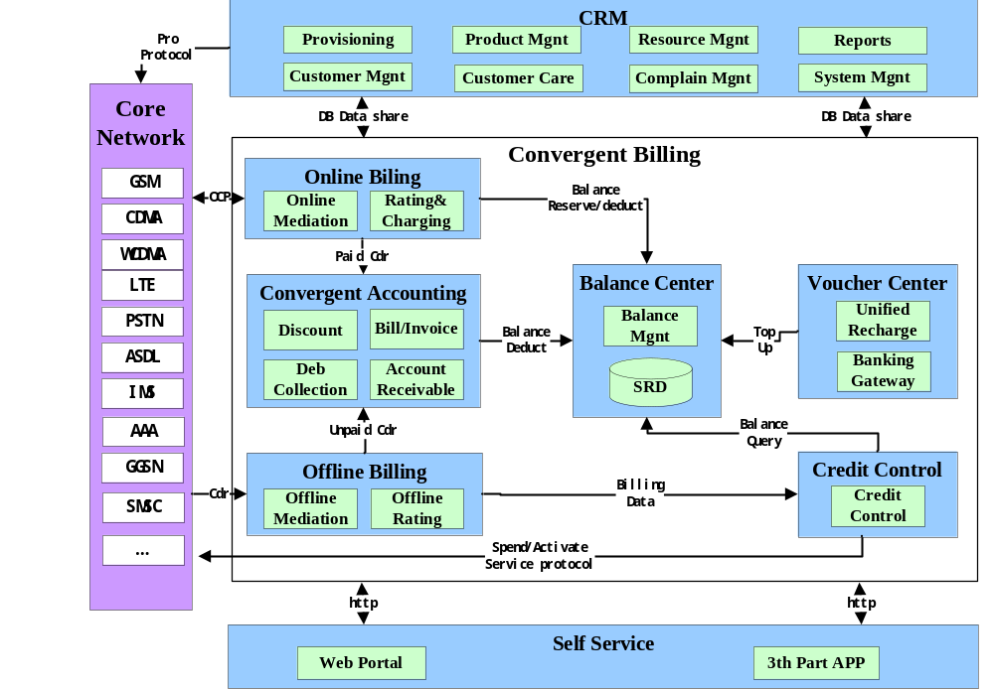
BOSS System Architecture
Notes:
1，各个中心之间的关系？
2，销账如何处理？

Slide 4
Contents
1
BOSS System Architecture
2
CRM Product Overview
3
Billing Product Overview

Slide 5
CRM Funtional Module
Portal
Payment
Query
Self-service
Acceptance
Announcement
Customer Management
Provisioning Service
Customer Information Management
Account Information Management
Customer Group Management
Instruction Configuration
NE Info Configuration
Product Management
Customer Care
Instruction Track
Product Configuration
Package
Configuration
Subscription
Management
Integrated
Enquiry
Pricing Plan Configuration
Product Catalog Configuration
Service
Changing
Batch Prepaid
Operation
Common Support
System Management
System Mgmt
System Mgmt
Resource Management
Complain & Trouble Ticket
Log Management
Log Mgmt
Card,imis Mgmt etc
Resource Info Mgmt
CT Creating
CT Tracking
Announcement Mgmt
Warehouse Mgmt
Announcement Mgmt
Inventory Mgmt
CT Handling
CT Reports
CT Report

Slide 6
Contents
1
BOSS System Architecture
2
CRM Product Overview
3
Billing Product Overview

Slide 7
Accounts Receivable
Configuration
Payment Method
Deposit Type
Refund Type
Single Transaction
Batch Transaction
Single Transaction
Batch Transaction
Adjustment
Refund
Batch Payment
Batch Refund
Payment
Deposit
Batch Adjustment
Transfer
Autopay
Transaction Query
Balance Query
Invoice Query
Service usage Query
Bill Query
Web Service
File
Web Service
CRM
Bank
Payment Gateway

Slide 8

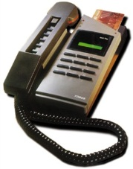
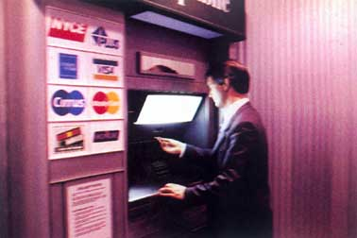
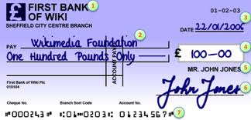
Accounts Receivable
Accounts Receivable
  The Accounts Receivable (AR) module provides the following transaction services in a postpaid service solution or hybrid service solution:
    Single services: adjustment, payment, payment reversal, Autopay, deposit, refunding, account transfer.
    Batch services: payment , account adjustment, advance deposit.
    Query services: query for invoices, account balance, outstanding fees, payment records, deposit details, adjustment logs and transfer logs.

Slide 9
Bill & Invoice
Bill Configuration
Customer Group
TAX
Discount
Bill S Rule
Discount
Bill S Rule
Charge
Aggregation
Bill Run
Bill
Management
Bill Run Prepare
Billing TAX
Billing Discount
Bill Run Design
Bill Run Prepare
Billing TAX
Billing Discount
Bill Run Prepare
Billing TAX
Billing Discount
CDR Load to DB
Bill Run Prepare
Bill Run Prepare
Billing Discount
Billing Discount
CDR Aggregation
Bill Run Calculation
Bill Formatting
Bill Generation
Bill Generation
Bill Generation
Bill Printing
Bill Confirm
Bill Delivery
File
File/DB
R&C
AR

Slide 10


Bill & Invoice
Bill
  The Bill module exports formatted bills, including running bills,generating bills in a special format, converting bill formats, and bill distribution
Invoice
  Invoicing component is responsible for generating bills and invoices for customers based on their usage of services and promotion strategies.

Slide 11


Debt Collection
Debt Collection
  The Debt Collection (DC) module collects payment from subscribers or accounts that have not paid fees by the due date. DC obtains debt information from AR.
  The collection methods include:
    Automatic dunning.
    Manual dunning. The DC provides a GUI for an operator to upload files, analyze file content, and perform dunning on subscribers accordingly.

Slide 12
Accounts Receivable
Accounts Receivable
  The Accounts Receivable (AR) module provides the following transaction services in a postpaid service solution or hybrid service solution:
    Single services: adjustment, payment, payment reversal, Autopay, deposit, refunding, account transfer.
    Batch services: payment , account adjustment, advance deposit.
    Query services: query for invoices, account balance, outstanding fees, payment records, deposit details, adjustment logs and transfer logs.

Slide 13
Creadit Control
  Targeted at post-paid users, there are substantial bills not charged. In order to control due and guarantee revenue, it is necessary to make real-time credit control on bills, due and balance not deducted. When user is beyond credit limit, it will be necessary to take halting and other treatment measures. Credit control is triggered depending upon change in user's bills and expenses in real-time control.
Real Time Credit Control
Trigger
Mode
Usage Fee
Recuring Fee
Topup
Control Action
Notification
Deactivation
Reactivation
......
Credit Control Factot：
1、Uncharged fees;
2、Due amount
3、Account Balance
4、Credit limit
5、White lists;
6、User’s data
Control Rule
Control Engine
。。。
Manual Credit Control

Slide 14

Voucher Center
Voucher
  Generating voucher cards
  Generate card number & password
  Period of card validity settings
  Manage card life cycle
  Replenishment
  Card authentication
  Determination of the attributes
  Query the balance of account
  Return the results of recharging
  Query transaction
  Discounting process

Slide 15
Reports
BOSS reporting module uses dynamic report generation software. BOSS user can add, modify, and delete all report elements by editing oracle database tables.
Reports are for making statistical analysis on data in the billing system and displaying them in certain form. Reports are of functions of flexible generation of statements and diversified presentation of statements so as to adapt to GUI user’s constantly varying demand.
GUI Users are allowed to define and customize reports which cover content list of data, format description and other information. The content list of statements is generated from data in the database through certain functional calculation.
GUI is offered, where users can set format of display at default, entries in sequence and other information. Formats of statements cover forms and graphs which support multiple formats such as pie chart, bar chart and gantt chart.
It is allowed to set authority for defined reports which are allowed to be viewed by authorized user only while other users are not allowed to see the content of reports.

Slide 16
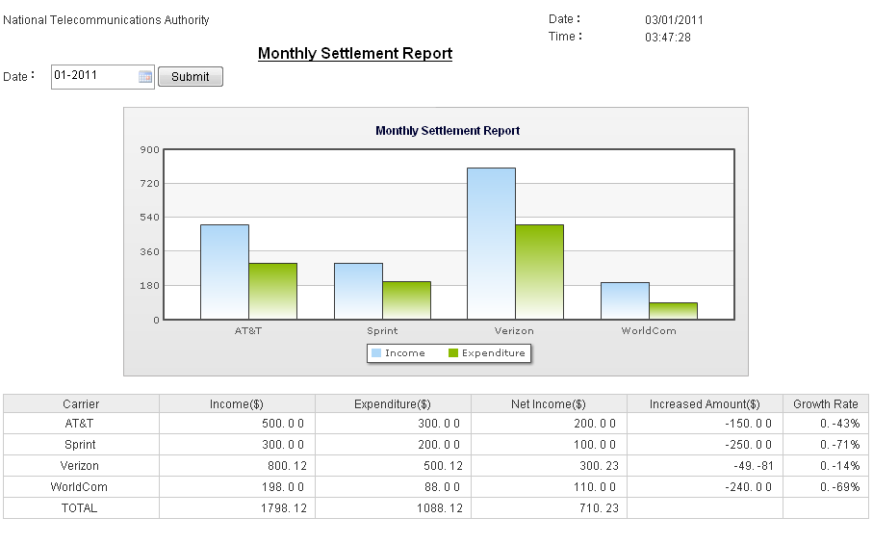
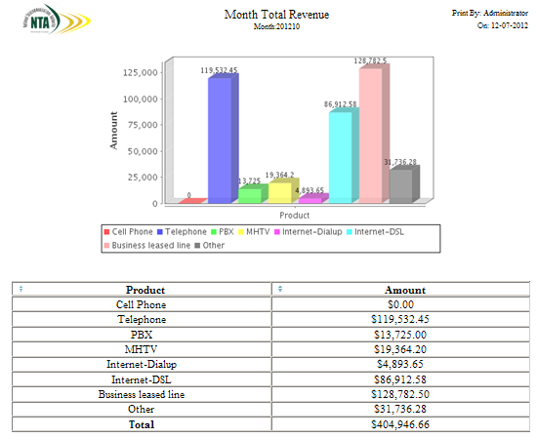
Reports
Built-in reports include
  Customer reports
  Revenue reports
  Service Usage reports
  Pop-up reports
  Order reports
  Etc.
Personalized reports
Transformation
  PDF
  XLS

Slide 17
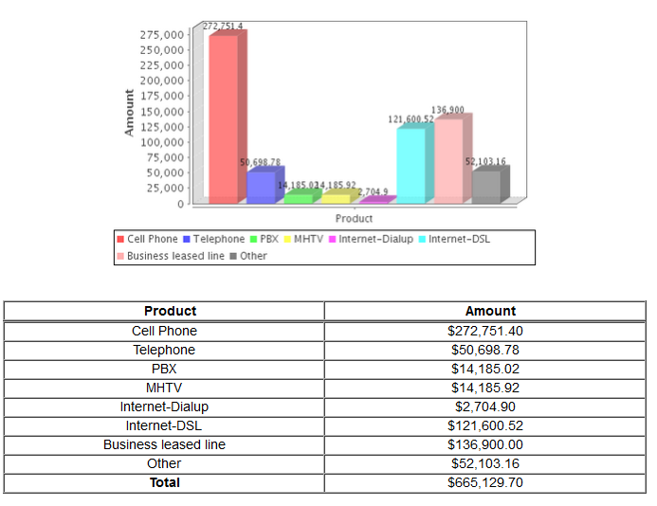
Month Total Revenue Reports

Slide 18
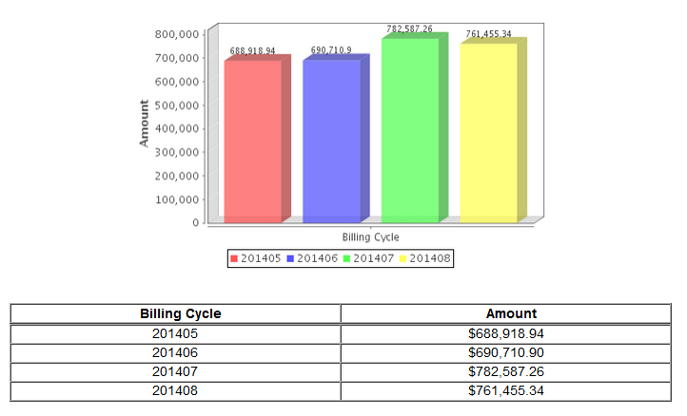
Compare Month Revenue Reports

Slide 19

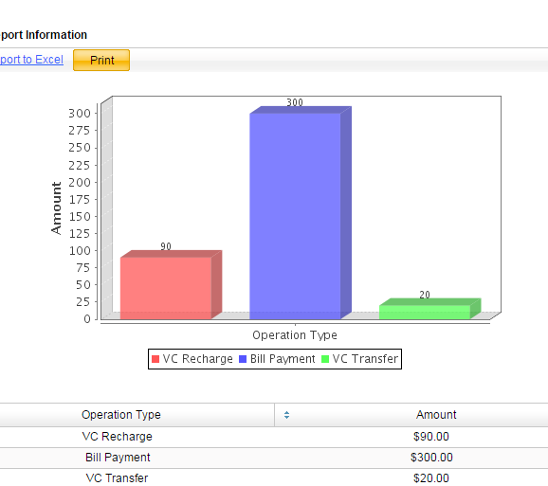
Payment Statistics Report

Slide 20
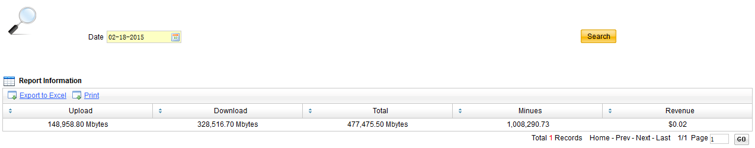
Internet Daily Traffic Report

Slide 21
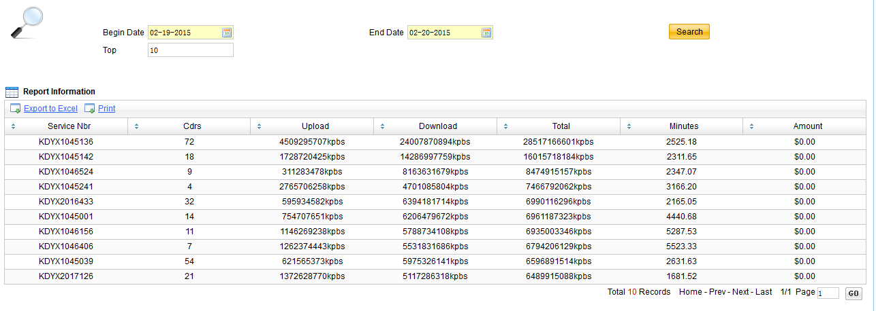
Internet Top User Reports

Slide 22
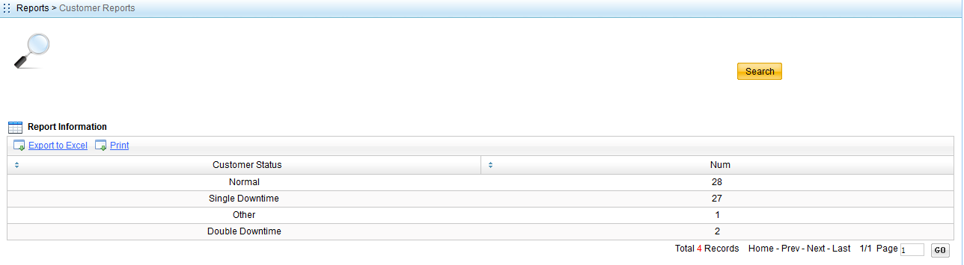
Customer Reports

Slide 23





Data Migration
Analyze
Extract
Transform
Loda
Verify
1、make the transformation policy.
Analyze the data model of the old system .
Compare the difference of the data modle between the old system and new system
Write a data transformation script.
2、extract data from the old system
3、transform the data
run the data transformation script to transform the data extract from the old system
4、load the data to the new system
5、verify the data

